Slide 1











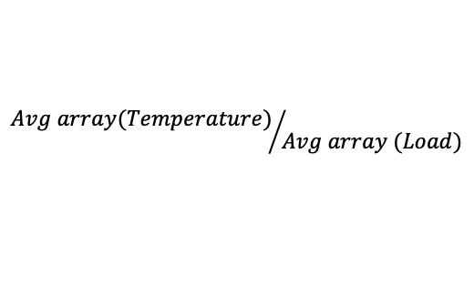

$$h_{n+1}−h_{n}$$
$$for each row of data for a particular combination of load zone and temperature station →store in an array$$
$$if 0 found at any “n” position, then,$$
$$ignore that particular itration of{ h}_{n+1}−h_{n} and,$$
$$manually insert 0 to that index of array$$
$$for a particular combination of “Zone ID” and “Station ID”$$
$$Average the values of all individual arrays index wise⇒The length of row wise arrays=length of overall average array$$
$$During the average process, the manually entered 0 values from previous iteration is ignored →only non zero values are considered$$
$$The averge array of that combination of load zone and temperature station is matched to the same combination array across both the files$$
$$Using individual and respective indexed elements the ratio array is calculated →$$
$${Avg array(Temperature)}/{Avg array (Load)}$$
$$The ratio array would have both negative and positive values based on the change in the hourly load and temperature values$$
$$If there is a negative value then there is no correlation for that hour of data and$$
$$If there is a positive value then there is correlation for that hour of data which means$$
$$This would indicate a proponailty among the temperature and load data afor each particular for a particular combination$$
$$The positive values are seperated and a new array is formed$$
$$Based on the length of positives array and the length of the overall array a positive percentage is calculated$$
$$For each load zone, there will be 11 tempature stations matched along with their positive percentage$$
$$The highest percentage indicates the best correlated “Zone ID” and “Station ID” →Documented in a .csv file$$
Load Zone
Values
Temperature Station
Values
combined_results.csv

